Slide 1
Russian Revolution
The Rise of Modern Communism

Slide 2
Background
Russia had rich tradition in absolutism; Czars (Tsars) ruling with unlimited power
Boyars- Russian nobles and landowners were small minority (1%); rest of country were serfs and peasants (4 out of every 5)…Haves vs. Have-Nots!
Overall, the country lacked industrialization (they were behind England and US)
Russian people were mostly isolated from European culture, especially those east of the Urals.
Russia has been a sleeping giant…but will soon be awakened…

Slide 3
Czars
Alexander III (father of Czar Nicholas)
“autocracy, orthodoxy & nationality”
Harsh ruler; ruled with an iron fist…Russia became a police state (spies/informers)
Avenged his father’s murder in peasant uprising
Issued pogroms (organized violence against the Jews). This is similar to Kristallnacht (“Night of the Broken Glass” – in WW II

Slide 4
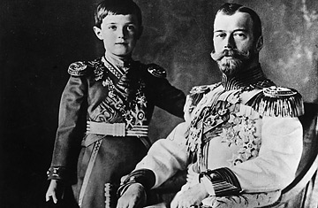
czars
Nicholas II
Son of Alex III….he carries on Romanov legacy (a devoted, loving, family man, even a jokester, however, he is a weak leader)
Goal: Industrialize Russia; be competitive with Europe; Steel Industry
Massive Industrialization raises taxes and creates harsh working conditions
Social unrest and talk of revolution
Fuels acceptance of communism
Czar Nicholas and the heir to the thrown, Alexi

Slide 5
Social Revolutionaries (Russian marxists)
Mensheviks
Means “minority”
Wanted to implement communism in Russia
Believed in educating the population about communism
Slow process to gain popular support
Willing to compromise time for effectiveness
Grass roots movement
Bolsheviks
Means “majority”
Wanted to implement communism in Russia
Believed in radical quick implementation w/out popular consent
WAR COMMUNISM
Leader:
Vladimir Lenin
EMERGED AS DOMINANT SOCIAL REVOLUTIONARY GROUP

Slide 6
Vladimir Lenin
1870-1924
Leader of the Bolsheviks
First to implement communism to any nation
Leninism: Marxism reworked to fit Russian culture
Father of Russian Communism and the Revolution…promised PEACE, LAND, and BREAD

Slide 7
Leninism
Lenin had to adopt Marxism to Russian environment. (not heavily industrialized)
Lenin helped spark a “revolutionary nationalism of the poor” in Russia
GOAL: to orchestrate the overthrow of the existing government by force and seize power on behalf of the proletariat and then implement a dictatorship of the proletariat (as per the Communist Manifesto)
The dictatorship of the proletariat is theoretically to be governed by a decentralized system of proletarian direct democracy in which workers hold political power through local councils known as soviets

Slide 8
Czar Nicholas’s Three Mistakes = Causes of Revolutoin
1. Russo-Japanese War- 1904
Meant to boost Russian morale, but Russia lost badly in their efforts to control Korea and Manchuria
Exposed the weakness of Nicholas and military
2. Bloody Sunday-1905 (“near Revolution”)
Nearly 1,000 unarmed petitioners led by a priest are killed @ Czar’s Palace. They were singing peaceful songs….only looking for better working conditions and freedoms
Nicholas isn’t there, but the military leaders order soldiers to squash the rebellion
Nicholas reluctantly creates the DUMA (Russia’s first Parliament- dissolved in 10 weeks…..this is a further weakening of Nicholas
This event broke the bond between the people and czar
3. World War I (1914)
Leaders are poor…..poorly trained soldiers….bow out of the war and sign treaty with Germany
Devastated the economy; millions killed
Misguided leadership of Rasputin in Czar’s absence

Slide 9
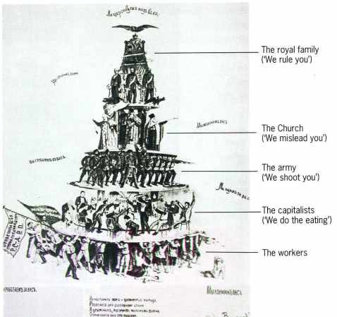
Look carefully at this Poly Cart? Who would be unhappy with this structure? What could they do?

Slide 10
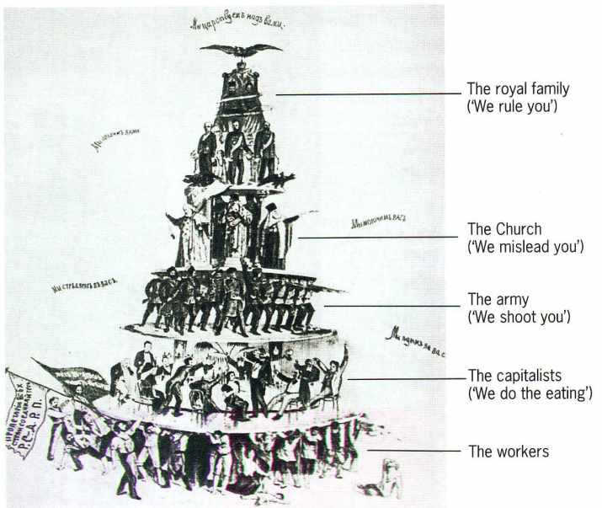

Slide 11
Rasputin – man of mystery
See p. 391

Slide 12
March Revolution-1917
Workers rioted in Petrograd; eventually gained support from soldiers
Forces Czar Nicholas II to abdicate the throne
Creation of Provisional Government
Lead by Kerensky-Leader of Petrograd Soviet
Decides to continue Russia’s involvement in WWI (mistake)
SOVIETS (small political groups made up of workers) grow in numbers…eventually they are more powerful than the Provisional Government; this is due to the Bolsheviks

Slide 13
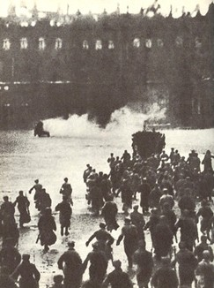
March Revolution-1917

Slide 14
Lenin Gains Control
October 24, 1917 Lenin seized power and dissolved Provisional Government
NEW SOCIALIST ORDER (NSO)
“PEACE, LAND, BREAD”
Peace with Germany
All farmland divided among peasants
Soviet-run gov’t (“Dictatorship” of the Proletariat)
Lenin’s policies not widely accepted by upper class – leads to civil war

Slide 15
Russian Civil War: 1918-1920
White Army (Mensheviks -loyalists)
Fighting to stop rise of Lenin and NSO
Received $$ aid from US and other European nations
Red Army (Bolsheviks)
Fighting to implement Lenin’s communism
Under the command of Leon Trotsky
Executed the Romanov Family
OUTCOME: Red Army win
Russian economy in ruins
15 million more Russians DEAD!! In addition to the casualties from WW1.

Slide 16
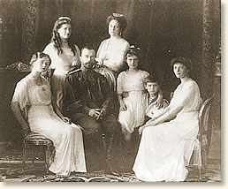
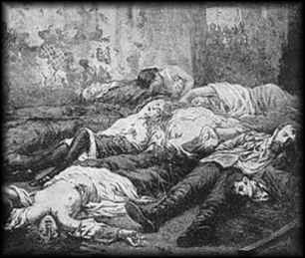
Execution of Romanov Family
During the early hours of July 17, 1918 Czar Nicholas II, his wife, children (1 boy and 4 girls) and servants were herded into the cellar of their prison house and executed by a firing squad…turn to p. 392 to read about the Mystery of Anastasia. The youngest of the 4 sisters.

Slide 17
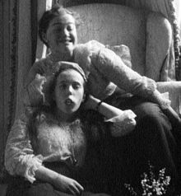
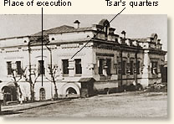
Execution of Romanov Family
In addition to the royal family, the executed included: their doctor, cook, valet, maid and dog.
It was rumored that Anastasia and one of her older sisters (Maria) cowered in the corner and escaped the initial onslaught of bullets. Their corsets were lined with jewels (hidden from the Cheka) and inadvertently served as a “bullet proof vest”, but they were eventually finished off by the Cheka.
http://www.history.com/topics/russian-revolution
https://en.wikipedia.org/wiki/Grand_Duchess_Anastasia_Nikolaevna_of_Russia
Grand Duchesses Maria and Anastasia making faces for the camera in captivity at Tsarskoe Selo in the spring of 1917

Slide 18
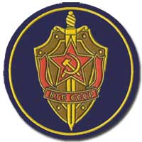
Lenin Restored Order
New Socialist Order (NSO) failed
Due to Civil War and “war communism”
Equality in economics was not working—no competition
Lenin implements CHEKA (secret police) to restore order and combat resisters. They would “manage Russia” through the Lenin and Stalin eras. Their name would change many times to eventually what they are today…..the KGB!
NEW ECONOMIC POLICY (NEP)
Created to fix the economic problems of NSO
Brought in small amount of capitalism
Successful and boosted economy

Slide 19
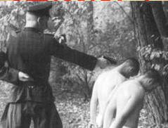
This is how Russia was “managaed” by the Cheka

Slide 20
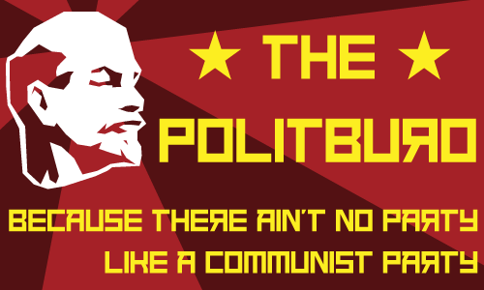

Slide 21
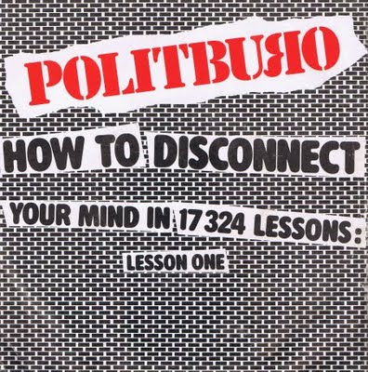
Lenin Restored Order
1922-Union of Soviet Socialist Republics
Changed party name from Bolsheviks to COMMUNIST PARTY
Politburo is the executive committee of the Communist Party (much like the President’s cabinet in the US)
Lenin’s new policies were improving and by 1928, production was where it was before 1914.
1924: Lenin dies after series of strokes (last year and a half he is a semi-invalid…no successor named until 1928)

Slide 22
Lenin’s Tomb (Mausoleum)
Found in Red Square in Moscow
Body of Lenin has been on display there since shortly after his death (few exceptions – War time….ex. WW2)
Between 1924-1972, 10 million people visited the tomb
Stalin’s embalmed body lay next to Lenin from 1953-1961
The body requires daily treatment and every 18 months it is removed and given a chemical bath
If you visit today, you cannot take pictures/video, smoke, talk, have your hands in your pockets, or wear a hat inside the tomb area
Entrance is FREE of charge
In January of 2011, a vote was taken to decide if they should bury Lenin. No action has been taken as of yet.

Slide 23
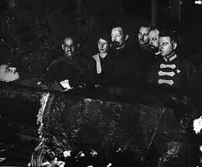
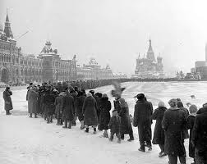
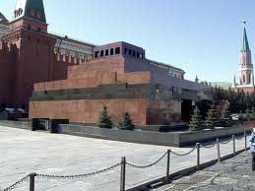
Pickled Onion

Slide 24
Who will take over the Union of Soviet Socialist Republics?

Slide 25
Josef Stalin 1928-1953
Eventually wins support from Communist Party to succeed Lenin in 1928
Was Secretary of the Communist Party
Stalin’s Personality:
Paranoid
Quiet
Ruthless
Ambitious
“The death of one man is a tragedy. The death of a million men is a statistic.”

Slide 26
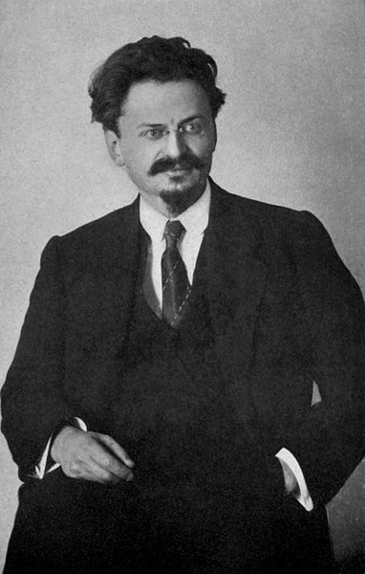
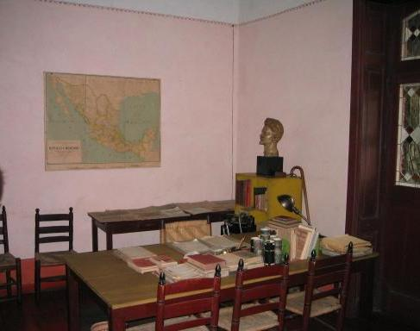
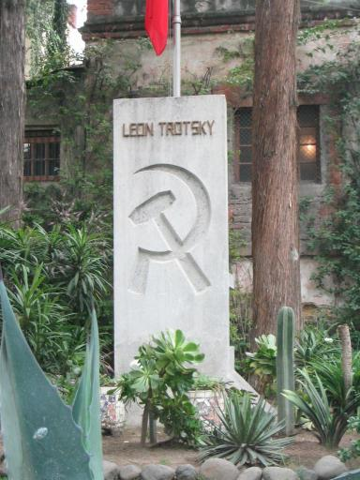
Leon Trotsky
Leon Trotsky was Lenin’s choice to succeed him
Stalin had him kicked out of the Politburo and exiled to Siberia (1927) and a year later he was expelled from Russia.
http://www.history.com/this-day-in-history/stalin-banishes-trotsky
Later he was moved to the following countries: France, Norway, and eventually Mexico.
He would be assassinated in Mexico City at the age of 60 (there were previous attempts on his life….Stalin is thought to be behind them)
An undercover NKVD agent (would later become KGB) struck him with an ICE AXE!!
He did not die instantly. He instructed his bodyguards to NOT kill the assassin so he would be able to stand trial.
Trotsky actually lives for a day before succumbing to the blunt trauma to his brain. – August 20, 1940
What happened to his killer?......
https://en.wikipedia.org/wiki/Ram%C3%B3n_Mercader
The office where he was attacked
Trotsky’s ashes are buried in Mexico

Slide 27
Stalin’s Goals
More extreme version of Communism
Command Economy
Industrialized Power
Extreme discipline
“Russia was ceaselessly beaten for her backwardness…because to beat her was profitable and went unpunished.” ~Stalin

Slide 28
STALIN PROPAGANDA

Slide 29
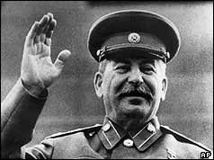
Political Ideology
Totalitarianism: a political system in which government has total control over lives of individual citizens
Marxism Leninism Stalinism!
This is not what Karl Marx had in mind!

Slide 30
Economic Policies
FIVE YEAR PLAN (1928-1932)
Increase industry (STEEL!)
Limited production of consumer goods
Increased production of military armaments
Increase agricultural production
Collective Farming (Collectivization)
2nd FIVE YEAR PLAN (1933-1938)
Increased production of consumer goods
Specialization of workers
Trained workers to become better skilled in specific areas
More efficient and better quality
More successful; USSR up to par with Europe

Slide 31
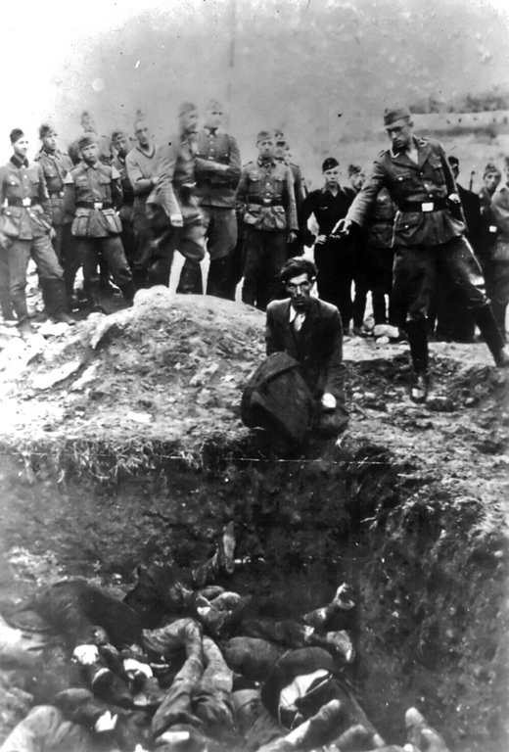
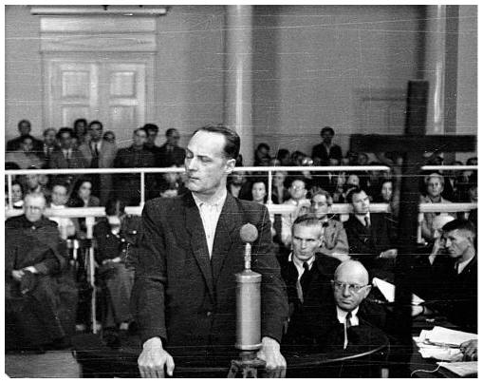
Purges
to purify; to rid of a specific group
Stalin’s paranoia becomes obsessive
1936-38: THE GREAT PURGE
archive data in 1937-38: the number of death sentences was near 700
Communist Party members, Red Army leaders, “saboteurs” were put on “show trials”, “indicted”, and put to death
http://www.history.com/topics/joseph-stalin/videos/stalins-purges

Slide 32
Off to the GULAG!
Gone to the Gulag: Diary of a Soviet schoolgirl (13:00-20:00)
What is the importance of the Gulag Museum…does it have value?
https://www.youtube.com/watch?v=CIrAD8wxm_I
Or see Favorites for Video Clip (8 min- Youtube)

Slide 33
GULAG Prison System
GULAG is the Russian acronym for The Chief Administration of Corrective Labor Camps and Colonies ( in Russian, of course)
Penal labor camp system of the USSR
Forced labor camps under direction of State Security
476 separate camps all over USSR
Most notorious in Arctic and Sub-Arctic regions
“SIBERIA”
Estimated 20-40 million passed through camps 1928-1953
Estimated 13 million died in camps from 1934-1953
Camps existed up through 1990’s
Siberian Labor Camps housed up to 1 million prisoners

Slide 34
GULAG

Slide 35
Gulag

Slide 36
GULAG SYSTEM

Slide 37
How Did I End Up Here? – A biographical look at the GULAG
Directions: You will be given a short biography on someone who was arrested by the Soviet police and sent to a GULAG. Using the information in the biography, answer the following questions and reflect on how you would feel if you were this person.
1. What is your person’s name? Age? Occupation? Sentence?
2. Why was your person arrested? What was your person convicted of?
3. Did your person confess to the crime? Under what circumstances did your person confess?
4. What type of work did your person perform at the camp?
5. In your opinion, what did your person feel was the worst phase of this process (arrest, interrogation, travel, or life at the camp)?
6. What was the biggest danger for your person at the camp?
7. What happened to your person?

Slide 38
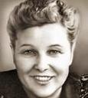
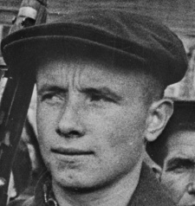
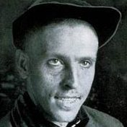
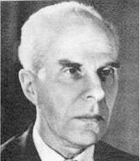
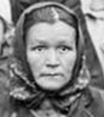
Natasha: Projectionist; 34 years old; 15 year sentence
Ivan: Soldier; 24 years old; 20 year sentence
Convicted of:
Confessed:
Work:
Worst Phase:
Biggest Danger:
Legacy:
Convicted of:
Confessed:
Work:
Worst Phase:
Biggest Danger:
Legacy:
Mikhail: factory worker; 34 years old; 10 year sentence
Convicted of:
Confessed:
Work:
Worst Phase:
Biggest Danger:
Legacy:
Sergei: Physician; 66 years old, 20 year sentence
Olga: peasant farmer; 40 years old; 10 year sentence
Convicted of:
Confessed:
Work:
Worst Phase:
Biggest Danger:
Legacy:
Convicted of:
Confessed:
Work:
Worst Phase:
Biggest Danger:
Legacy:

